Slide 1

ENVIRONMENTAL MONITORING SYSTEM
SRI HARSHA MITTAPALLI – 2869008
PRANAY KUMAR GATTU – 2872692
SAI CHARAN REDDY KUMBHAM – 2859573
SWATHI TAKKELLAPATI – 2872600

Slide 2

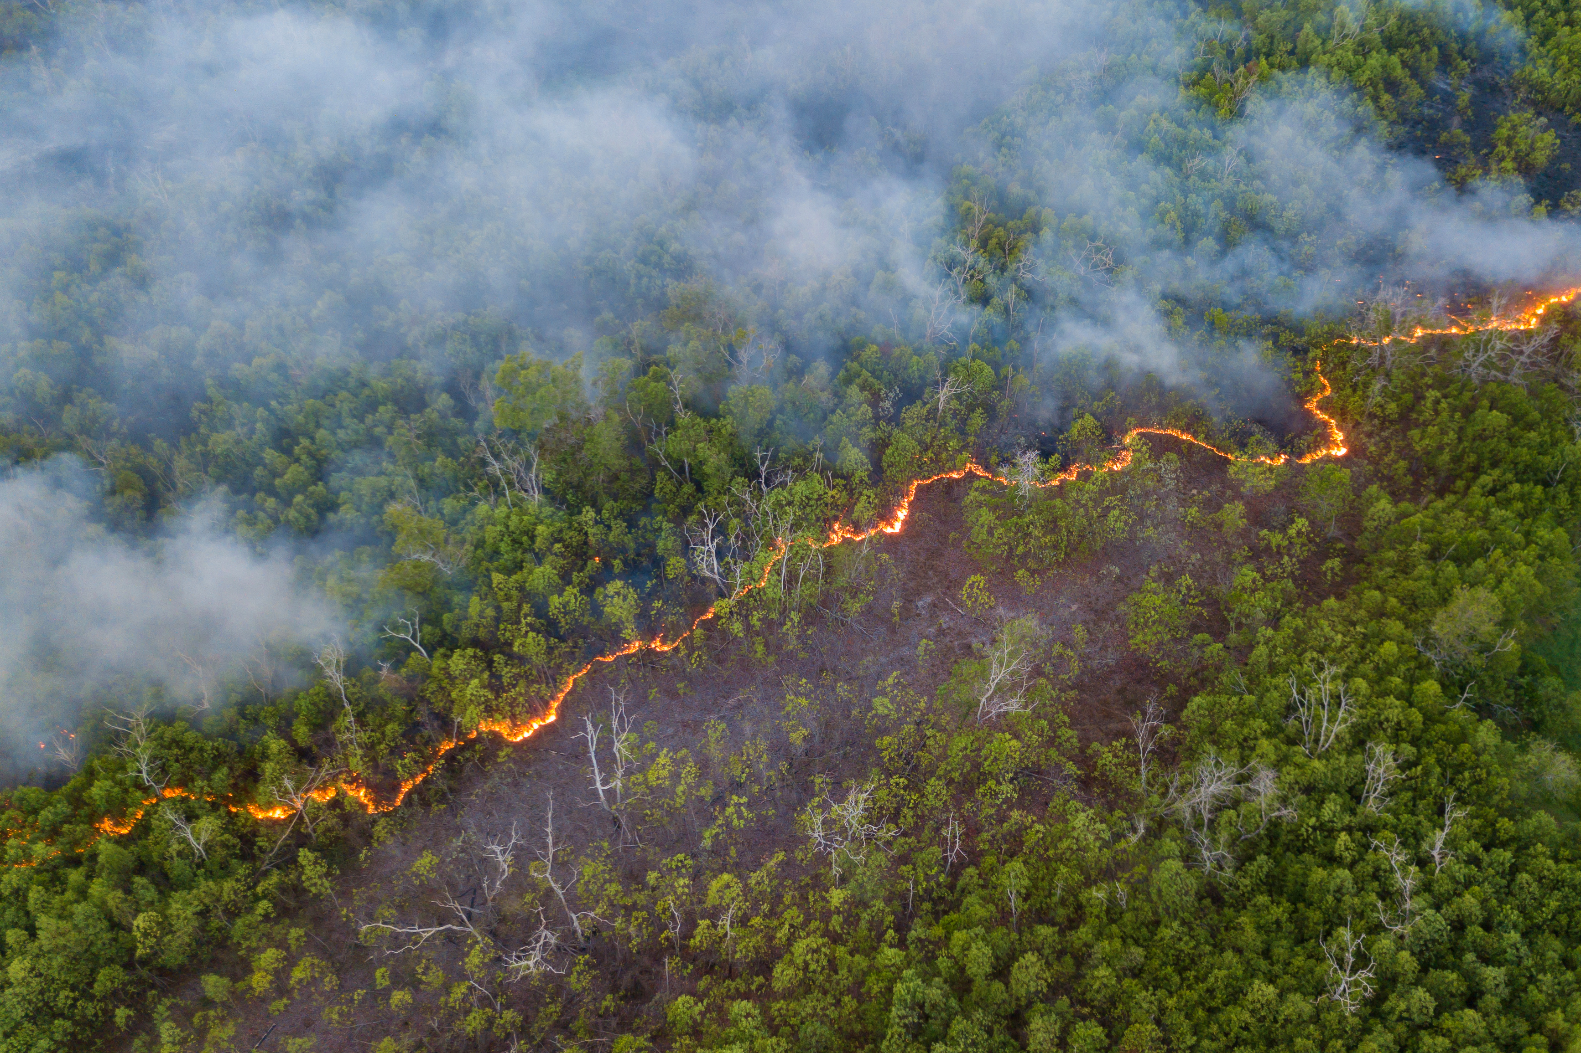
The Problem :
Environmental pollution is a growing concern over the world, and it has become important to monitor environmental conditions in order to recognize and address potential hazards and threats.
Issues with traditional monitoring systems :
Devices which does not produce accurate data.
Difficulty in monitoring individual environmental factors.
Time Consuming
Dependency on multiple sources of information.
Difficulty in integration of other traditional systems.
Required special knowledge to use existing monitoring systems.

Slide 3

IMPROVED SOLUTION :
The ems-anytime application is a solution to monitor these parameters continuously using several sensors and transmit the sensor data to a cloud server using the internet.
Extracted data can be analyzed, displayed in a user-friendly application, and display messages as needed with a pre-defined threshold.

Slide 4

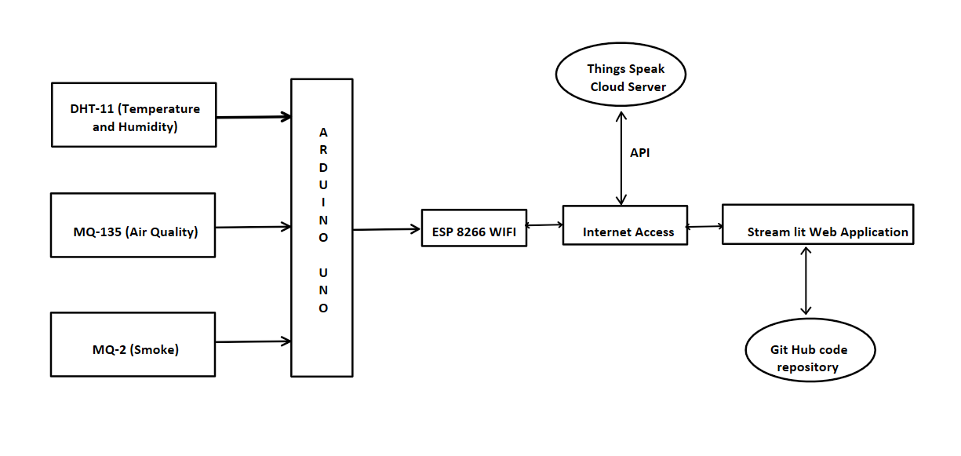
Design
Environmental Monitoring System Architecture

Slide 5
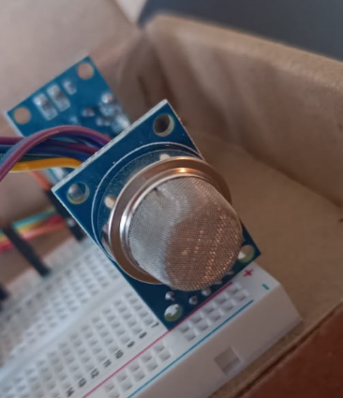
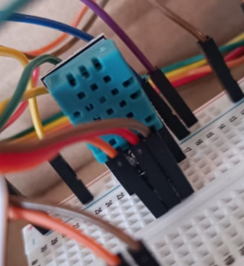
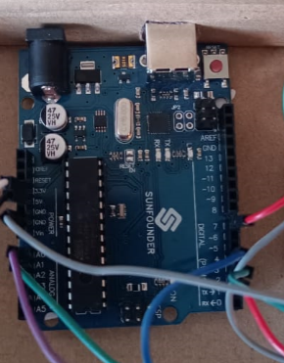
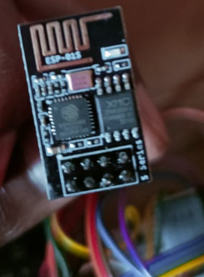
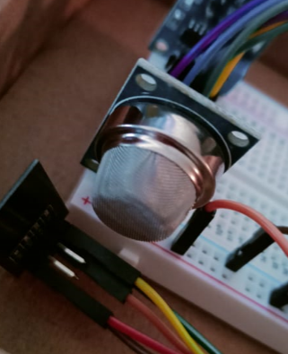
Components used:
MQ-135
(Air Quality)
DHT-11
(Temperature and Humidity)
ARDUINO UNO
ESP8266
(Wi-Fi)
MQ-2
(Smoke)

Slide 6
What has been done till now
Assembly and coding of all the sensors has been completed.
The ThingSpeak cloud server has been configured with multiple channels to receive data and the system has been connected to ThingSpeak using APIs.
The web application has been implemented using the Streamlit library and has been hosted on the internet successfully.
Report is under progress. (Draft 1 initiated)

Slide 7
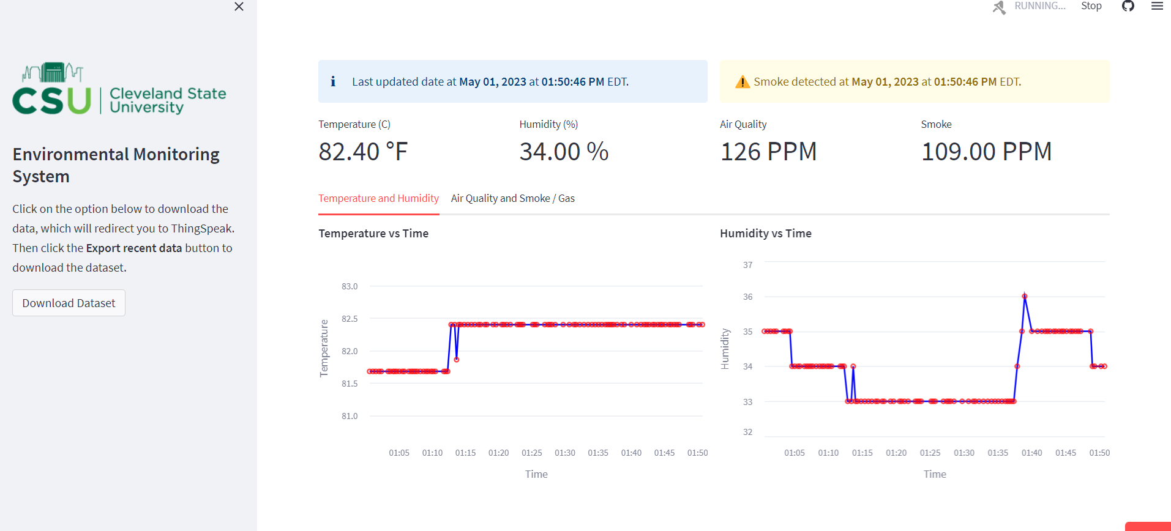
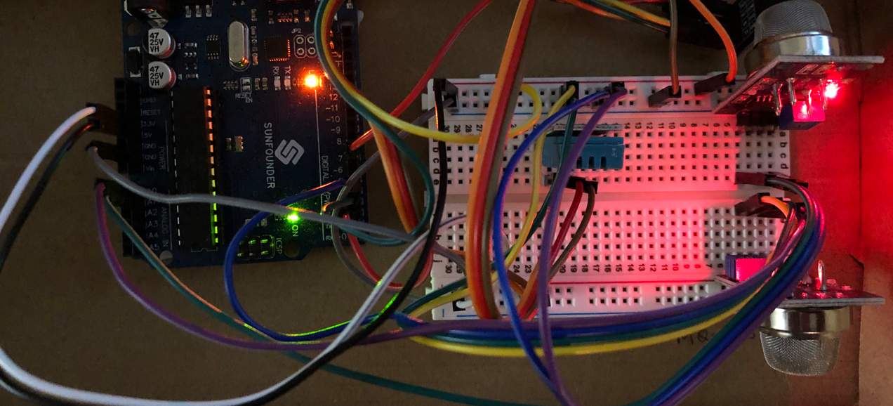
Results
Data has been collected from the sensors and transmitted to a web based interface.
Temperature
Humidity
Smoke
Air Quality

Slide 8
Conclusion
We encountered difficulties in coding and assembling the sensors, especially since using the Arduino IDE to program the sensors was a new experience for our team.
Additionally, connecting the system to the ThingSpeak server and creating a real-time application using streamlit that does not crash while ensuring code optimization was challenging.
However, thanks to the overall contribution of our team, we divided the work into subtasks and integrated them, which allowed us to successfully complete the system.
Finally, we hosted the web application on the internet using streamlit community cloud.

Slide 9
QNA

Slide 10
Thank you

